Slide 1
Module 3
Overview of Flex architecture: Facebook, Angular JS example, Differences between HTML and Flex applications, Angular JS example, Flex example, Understanding ActionScript, Flex example, differentiating between Flash player and Framework, Flex example, Understanding UI Components, Model View Controller

Slide 2
Introduction
Adobe Flex is an SDK (Software Development Kit) that includes a User Interface Framework, a command line compiler and other tools.
The output of an Adobe Flex application is either a SWF(SWF (/ˈswɪf/) is an Adobe Flash file format used for multimedia, vector graphics and ActionScript., which runs in the browser based Flash Player, or an AIR file which will run in conjunction with Adobe's desktop runtime.

Slide 3
Platform for building RIA
Based on eclipse IDE
Originated in Adobe Flash environment
Can develop cross plaftform application
Is cross browser compatible
Applications are compatible with Flash lite embedded systems(Mobile, PDA)

Slide 4
Why flex
Free, open source framework for building highly interactive web applications
These apps will work consistently on all major browsers, desktops, and operating systems
Scalability
designed to scale from simple components in websites to full-blown browser-based or desktop applications
using the pre-built component library, Flex provides a broad solution for creating RIAs of all kinds
developers can select data transport methods including support for XML over HTTP or Adobe's Action Message Format (AMF)

Slide 5
Prerequisites- ADOBE FLEX
Adobe flex Builder 3
Flex 3 SDF
Sun Java Runtime environment 1.4.2 or later
200 MB of available hard disk space
Adobe flex builder interface
512 MB of RAM (1GB recommended)

Slide 6
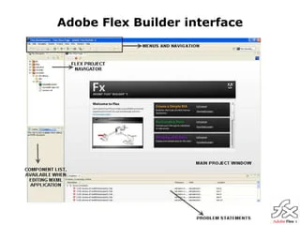

Slide 7
Flex is a powerful, open source application framework that allows you to build traditional applications for browser, mobile and desktop using the same programming model, tool, and codebase.
Flex provides FLEX SDK consisting of the Flex class library (ActionScript classes), the Flex compilers, the debugger, the MXML and ActionScript programming languages, and other utilities to build expressive and interactive rich internet applications (RIA)
Flex takes care of the user interface (UI) or the client-side functionality of a web application. Server-side functionality is dependent on server-side components written in a traditional scripting language (Java/ PHP etc.)
A Flex based application actually delivered as a SWF file and it closely resembles the HTML / JavaScript portion of a traditional web application.
Flex application is deployed as SWF file(s) plus an HTML wrapper, the CSS file(s) and any server-side script files (i.e. Java, .CFM, .PHP, etc.) to the server. Like traditional web applications.

Slide 8
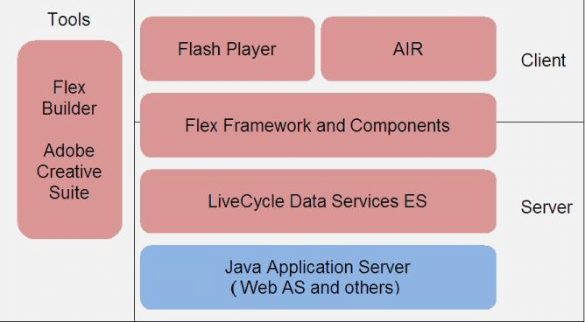
Flex Architecture

Slide 9
An AIR file is an archive file that contains the application files, which are all of the files contained in the project's bin folder. In this simple example, those files are the SWF and application XML files. You distribute the AIR package to users who then use it to install the application.

Slide 10
Flex components/tools
Component library provides user interface controls
Simple buttons, checkboxes, and radio buttons
Complex data grids and combo boxes
Developers use provided components to design complex layouts and use (or modify) the skins for a better look

Slide 11
Flex events
Flex applications are event-driven When the user interacts with an interface component or when changes occur in the appearance of a component, an event is dispatched
When an event is dispatched, event listeners,also called event handlers, designed in ActionScript are called on to process the event

Slide 12
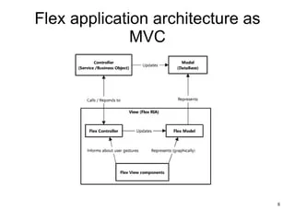

Slide 13
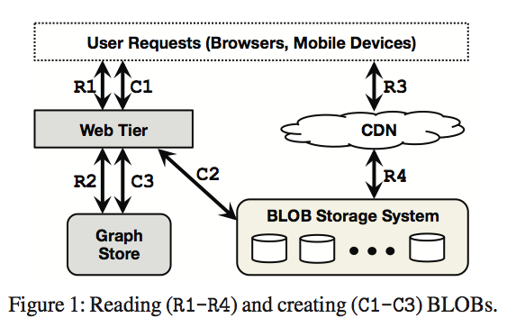
FACEBOOK

Slide 14
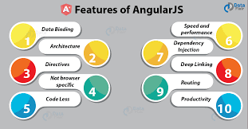
Angular JS
Angular JS

Slide 15
Difference between Flex and HTML
Flex is part of Adobe's Flash Platform.
The Flash Player: Flash Player is a browser plug-in which allows us to deploy web based applications to Windows, Mac, Linux, Android, and Blackberry.
Adobe AIR: Adobe AIR is a runtime that allows us to deploy native applications to Windows, Mac, Android, iOS, and Blackberry.
Flash Professional: Flash Professional is a tool for developing timeline based animations.
Flash Builder: Flash Builder is an IDE to help programmer's write advanced code.
Adobe Flex: Flex is the Software Development Kit that helps programmers build, debug, and deploy Enterprise applications with the Flash Platform. Flex includes a UI Component library, a SWF compiler, a command line debugger, an application profiler.

Slide 16
HTML 5
HTML5 is a spec for the next version of HTML. HTML is a markup language for building web pages. It includes some new aspects for dealing with video (Video Tag) and for creating animations (Canvas).
HTML5, alone, is not a good choice for building Applications.
However, when most people talk about HTML5 they also lump in JavaScript--which is a language used primarily for modifying a web browser's Document Object Model--and CSS3 which provides advanced styling support for HTML5 elements.
HTML5, combined with JavaScript and CSS3 can be a good choice for building the UI for a browser based mobile web application. HTML5 support on mobile devices is very consistent because the major mobile OSes (Android and iOS) use the same rendering engine (WebKit) in their respective browsers.

Slide 17
Difference between flash and flex
Before a top-quality Website falls into place, Web masters gather to help create a site that will be the best for everyone’s interests. If there is a Website, there is a Web programmer and a Web designer. The Web programmer deals with the codes that is the special language of the Web. A Web designer deals with the graphics and the arts. Everybody is mistaken if you think that all Web programmers can do what Web designers do and vice versa. Though they both work on computers and the Web, they have different areas of specialization.
But now Adobe has thought of a way how a Web programmer can be a Web designer, and how a Web designer can be a Web programmer. Have you ever heard of flash and flex? Probably, you have mostly heard of Flash since any Website suggests downloading a flash player for you to play a certain video. This article will provide you with the differences between flash and flex.

Slide 18
Differences contd..
Flash and flex are composed of the same genes. They are built under the same technology. Flex is like the brother of flash, the new generation type. Flex has more added features. In short, you can do anything with flex even without flash. Flex is a more detailed application. In flash, you can also do anything flex can do. You will just undergo a long process, but in the end you will get there.

Slide 19
Differences contd..
Flash provides you with great animation controls. You can be at ease making your animated graphics since flash has easier animation controls than flex. It also provides you quality sound control. And because flash was developed earlier for the Web world, it is more familiar to Web designers. Since flash is user friendly, most designers can now do a little programming with the help of flash. But most often they can only make it work a little since designing and programming are two very different skills.

Slide 20
